Slide 1

Shaping the Future of Higher Education (Mini-Conference)
24th July-Petra University, Jordan
Towards a Comprehensive Vision for Re-Imagineering Higher Education
(Shaping the Future of Higher Education
Promoting Sustainable Development Goals)
Prof. Amani G. Jarrar
Philadelphia University

Slide 2



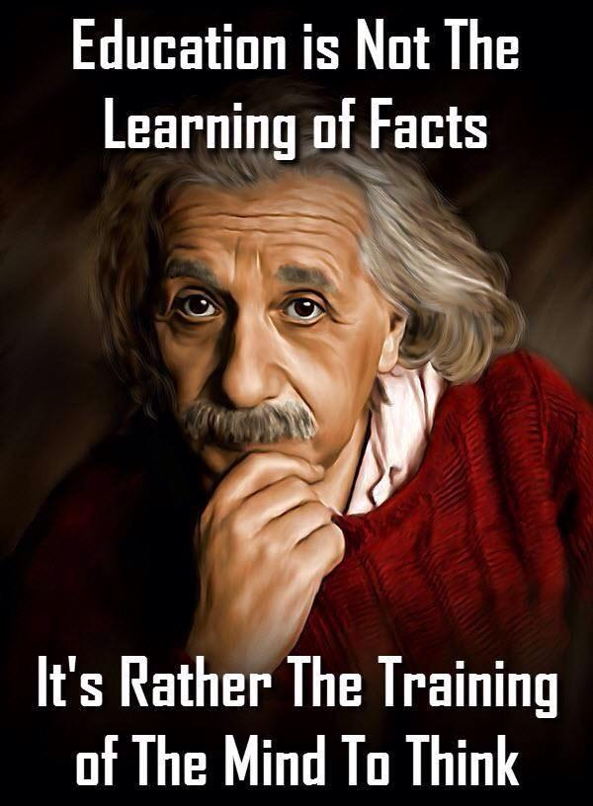
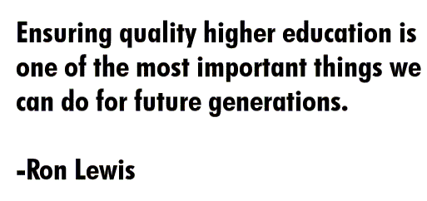
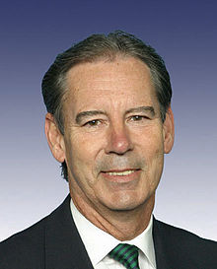
Member of the United States House of Representatives

Slide 3
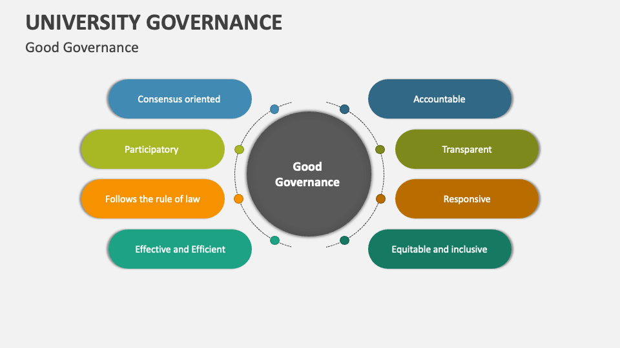
Source: https://www.collidu.com/presentation-university-governance

Slide 4
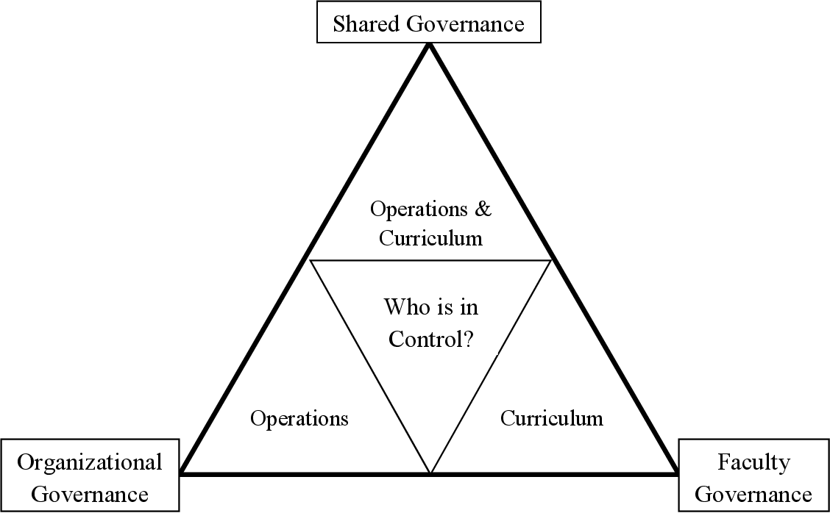
The relationship between organizational governance and faculty governance in higher education.
Williams, M. C. (2015). The relationship between organizational governance and faculty governance in higher education: A national study of shared governance (Doctoral dissertation, Texas A&M University-Corpus Christi).

Slide 5
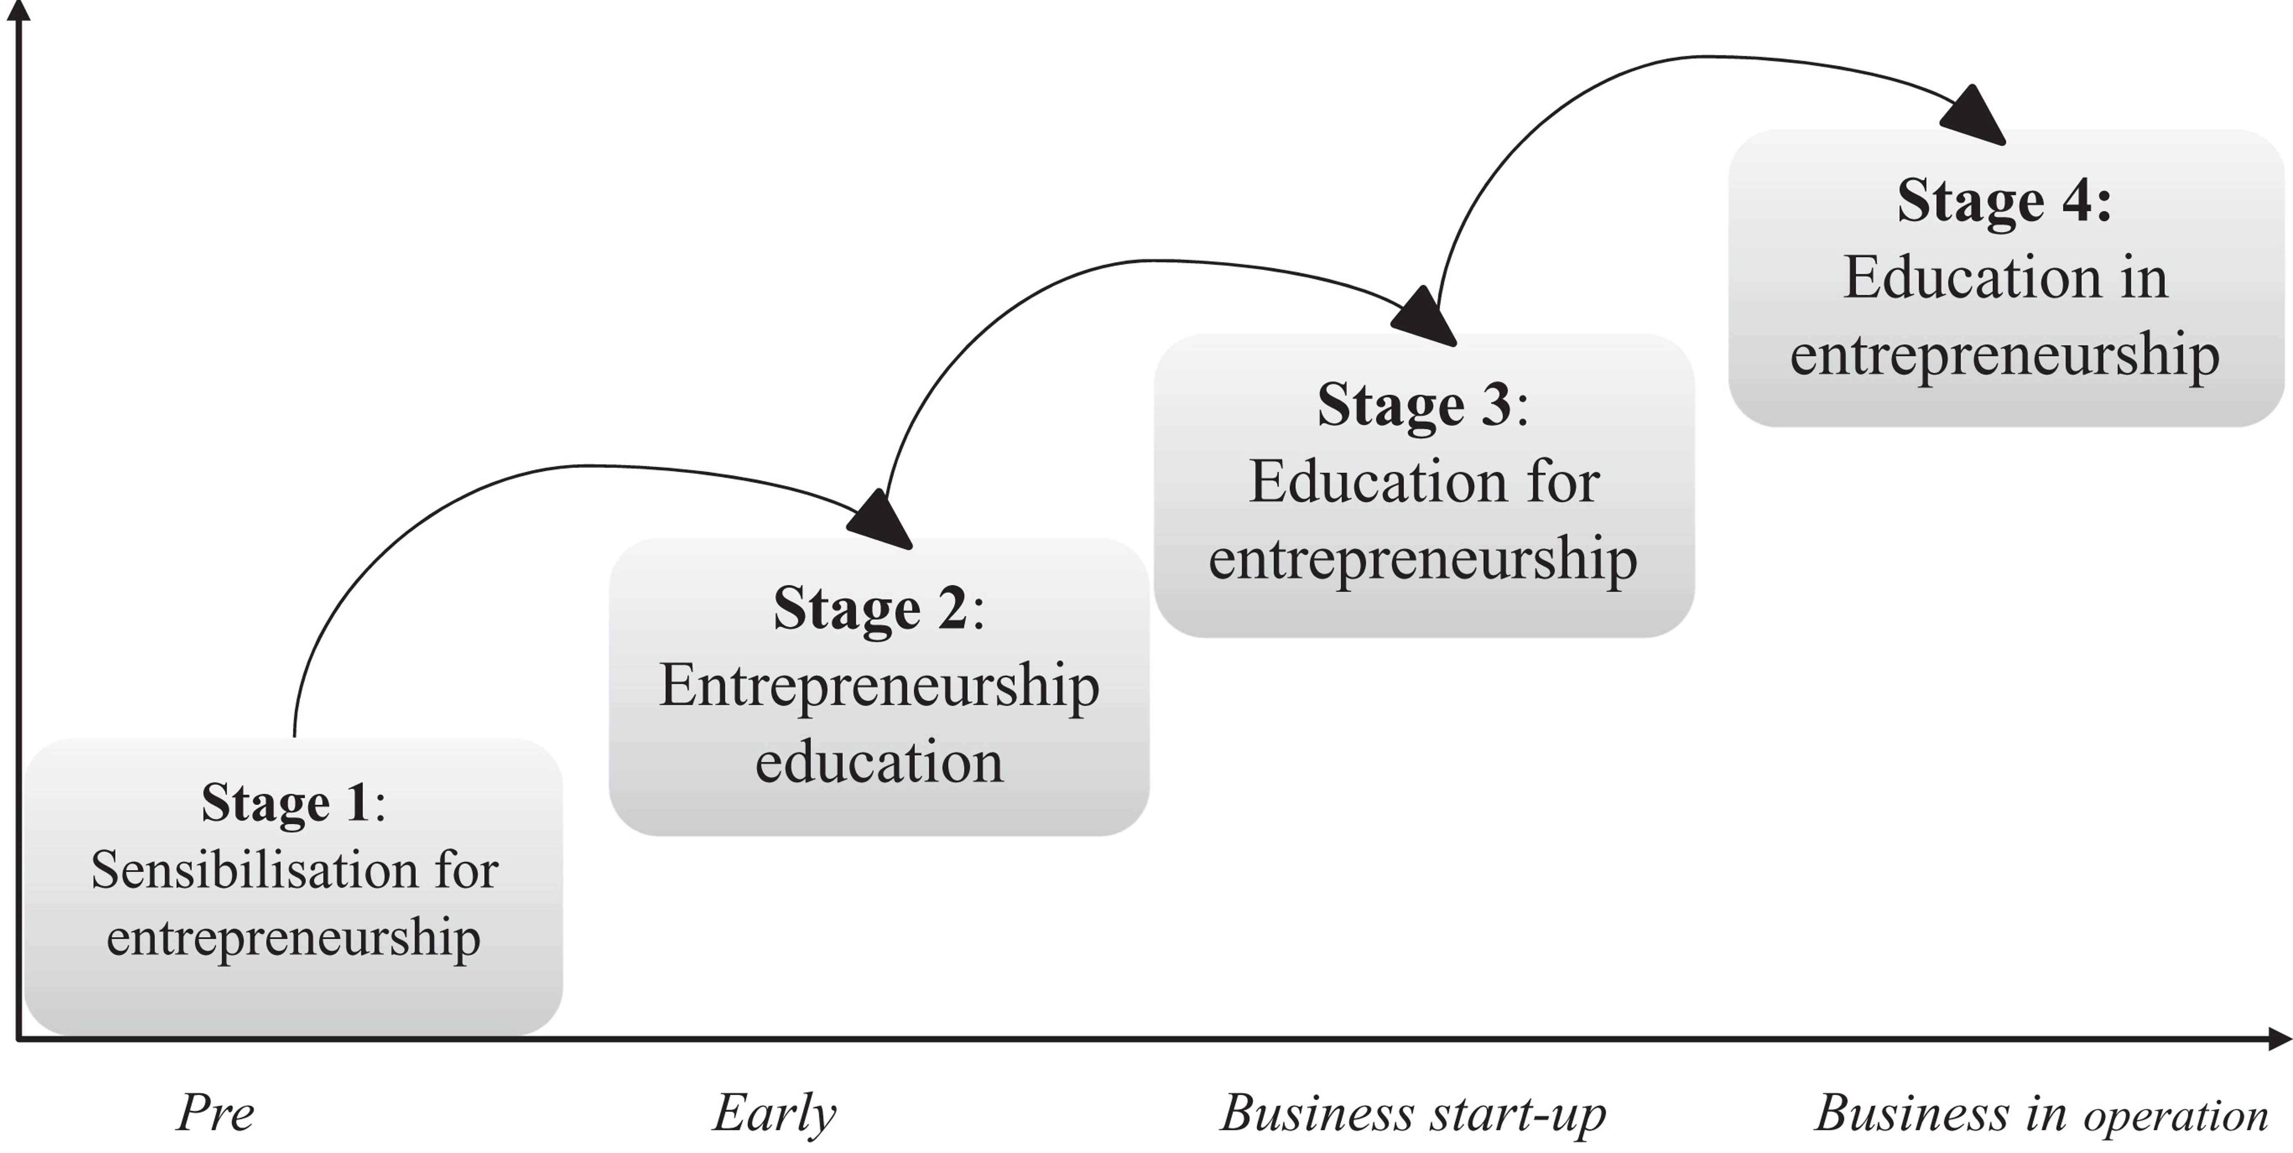
Entrepreneurship Education and the Role of Universities in Entrepreneurship
Davey, T., Hannon, P., & Penaluna, A. (2016). Entrepreneurship education and the role of universities in entrepreneurship: Introduction to the special issue. Industry and higher education, 30(3), 171-182.

Slide 6

Re-Imagineering Higher Education
(TQM)
Higher Education can adopt the Total Quality Management (TQM) principles, in which at least four main areas must be met.
First, the application of TQM is to improve administrative and operating functions or, in general, to manage higher education.
Second, TQM is integrated into the curriculum.
Third, TQM is used in classroom teaching.
Fourth, TQM is employed to manage higher education research activities.

Slide 7
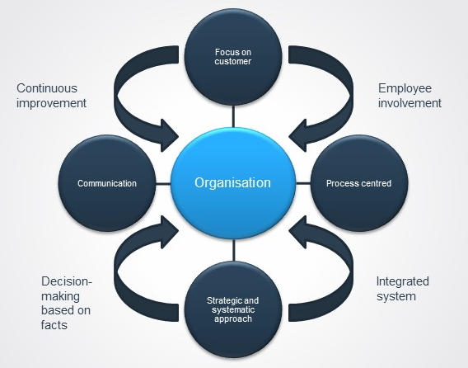
Total Quality Management (TQM) As a Corporate Strategy in Higher Education
Source: https://newcluk008.blogspot.com/2018/08/total-quality-management-tqm-as.html?m=1

Slide 8
Importance and Benefits of TQM in Higher Education Institutions (HEIs)
In the modern scenario of society, HEIs are forced to implement strategies within a global context.
Total Quality Management(TQM) has been described as a management philosophy and a way of thinking that has helped higher education institutions move towards achieving excellence in providing education.
To ensure high-quality services, market needs and satisfy the needs of stakeholders TQM must be widely recognized and successfully implemented in HEIs.
Adoption of TQM will be helpful for institutions of higher education for maintaining their competitiveness. In the 21st century, most higher education institutions are facing more or less the same problems globally.
To overcome challenges is very important to compete, survive and achieve excellence.
Through the achievement of various benefits such as improving the quality of service or product, reducing the cost, and increasing the production capacity the concept of TQM can be fulfilled.

Slide 9
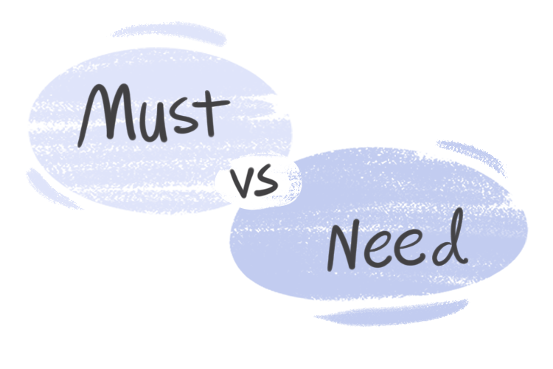
We Need To…
Redirect the future of higher education towards an (Education Area) that is sustainable, responsible, peaceful, democratic, collaborative, and prosperous.
Shape the (Future) We Want; as Higher Education can and must play a decisive role in providing learners across the world with knowledge, competencies, and values to discover solutions to today’s sustainability challenges.
We Must

Slide 10
Re-Imagineering (The Concept)
Re
Derived from Latin, again: anew
Engineering
Involved in the design, evaluation, development, testing, modification, inspection, and maintenance of a wide range of products, structures, and systems.
Imagination
The ability to imagine things that are beyond knowledge, and the ability to form systems in our mind of something that have not seen or experienced.

Slide 11

Re-Imagineering Higher Education (Keystones)
Combine the best practices of education to create engaging and immersive learning experiences.
Combine creativity with technical know-how that results in innovative ideas that can transform our educational institutions.
Although higher education systems are in a constant state of change, they are difficult for the public and private sectors to reform. And for increasing higher education efficiency; establishing mechanisms to coordinate the development of higher education systems is a must.

Slide 12

Re-Imagineering Higher Education (Facts)
Higher education creates lifelong opportunities that promote economic success, political participation, and other benefits.
Source: Mejía-Manzano, L. A., Sirkis, G., Rojas, J. C., Gallardo, K., Vázquez-Villegas, P., Camacho-Zuñiga, C., ... & Caratozzolo, P. (2022). Embracing Thinking Diversity in Higher Education to Achieve a Lifelong Learning Culture. Education Sciences, 12(12), 913.
Attention must be drawn:
To the need for effective policy structures to manage higher education,
To link the costs of reforms to benefits such as increased opportunity,
To take account of the institutional constraints to change as well as to carefully articulate educational reforms with other public policies that influence the performance of the higher education systems.

Slide 13
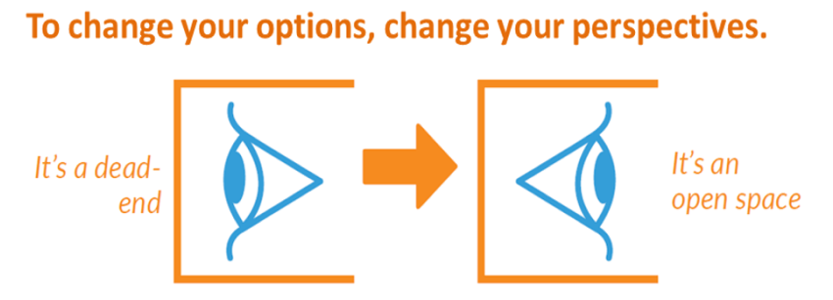
Re-Imagineering Higher Education
(Possibilities)

Slide 14
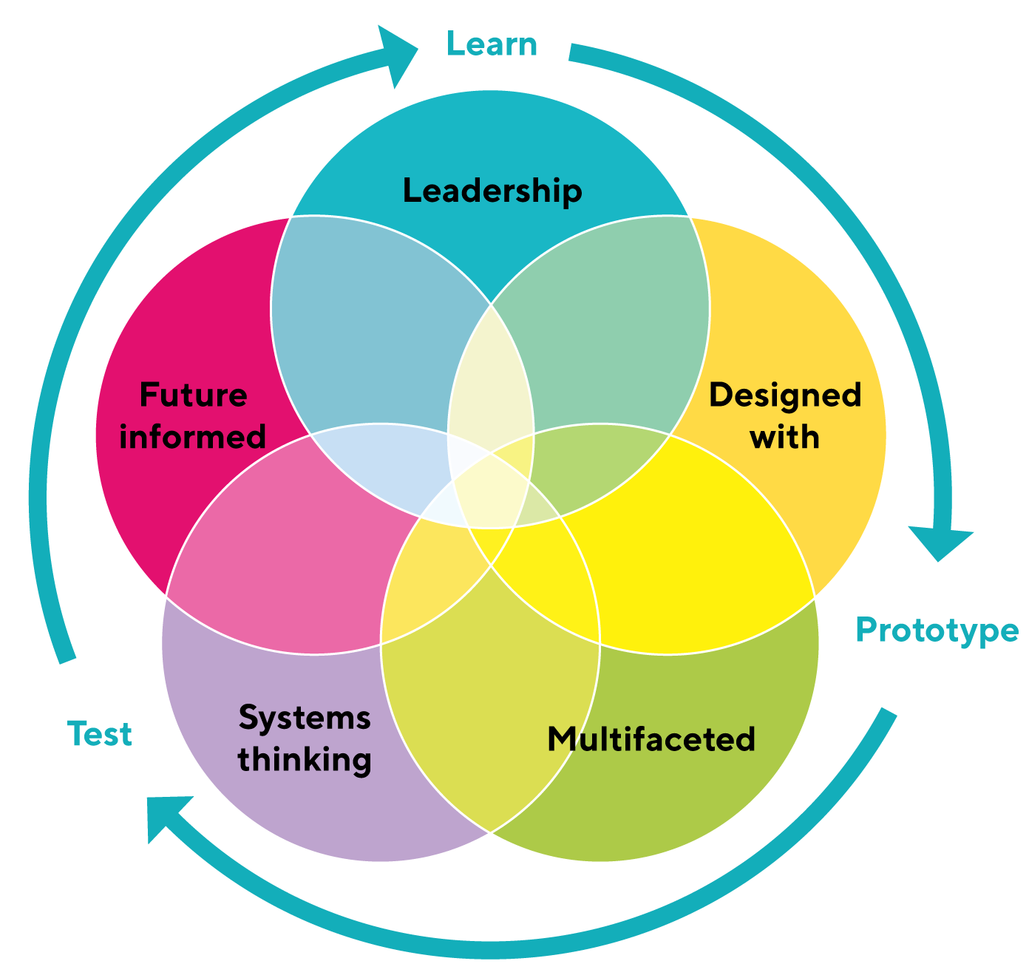
Re-Imagineering Higher Education (Possibilities)
Learn | Prototype | Test
Analyze
Plan
Feedback
Leadership | Leaders of Higher Education play a significant role in creating a culture that is essential for its faculty and other employees to cultivate the habit of continuous professional development and this can happen through a culture of paradigm shift.
Planning Must be…. | Designed upon deep analysis Multifaceted with smart alternatives Powered with suitable thinking systems And must be with a future vision
Source: Haider, S. A., Akbar, A., Tehseen, S., Poulova, P., & Jaleel, F. (2022). The impact of responsible leadership on knowledge-sharing behavior through the mediating role of person–organization fit and moderating role of higher educational institute culture. Journal of Innovation & Knowledge, 7(4), 100265.

Slide 15

Re-Imagineering Higher Education
(Leadership)
Importance of Leadership in Higher Education
Having leadership skills is helpful in many fields, but it’s crucial in higher education.
When you work in this field, you might be responsible for supervising employees and staff members or for teaching students.
No matter what your specific duties and responsibilities are, you’ll need to put leadership skills into practice in order to be effective.
Being a good leader can help you when it comes to making major decisions at your educational institution or determining which goals to focus on.
When you encounter challenges in this type of job, having leadership qualities can also make it easier to handle them.

Slide 16





Re-Imagineering Higher Education
(Effective Leadership in Higher Education)
Passionate About Higher Education Quality

Slide 17

Re-Imagineering Higher Education
(Effective Leadership in Higher Education)
Leaders Are Planners
They Develop Strong Connections
They Are Data-Driven
From Tolerance to Acceptance
They Empower Their Colleagues
They Encourage Risk-Taking

Slide 18
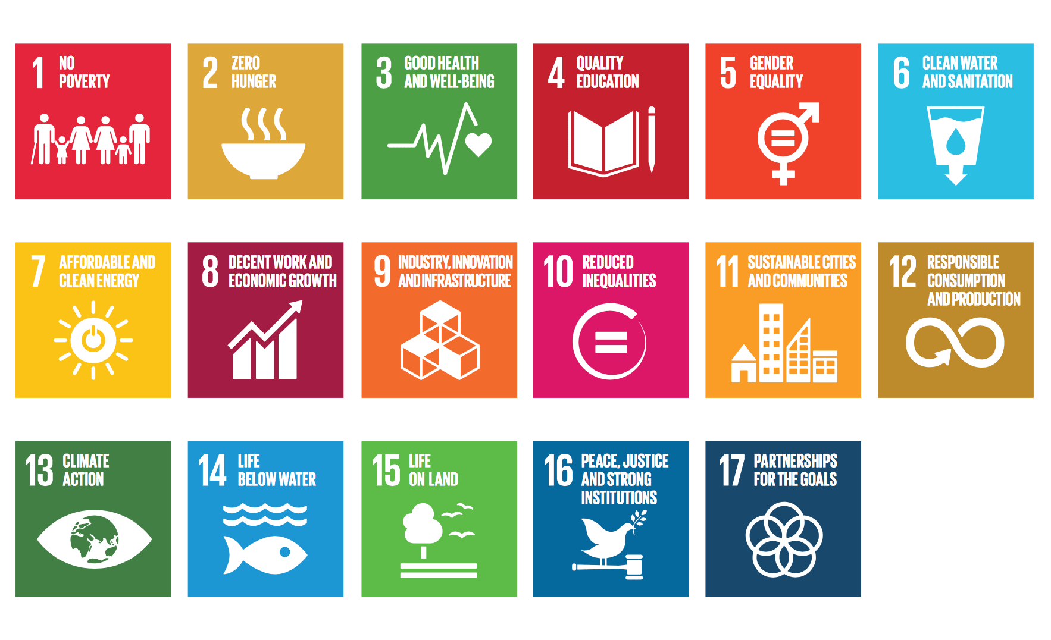
Re-Imagineering Higher Education
(Promoting Sustainable Development Goals)

Slide 19
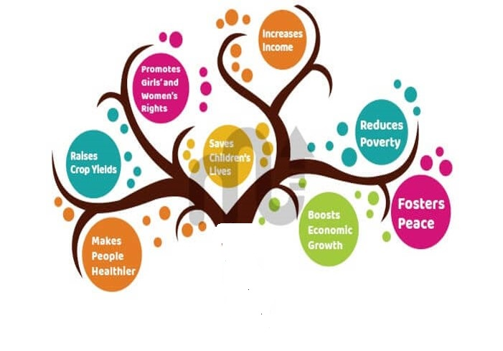
The quality of Higher Education systems is central and fundamental to individuals and countries alike. At the individual level, education affects future income, employability, health, and even family structure. On the national level, quality education reflects positively on economic growth, reduces poverty levels, and enhances social justice.
Higher Education

Slide 20
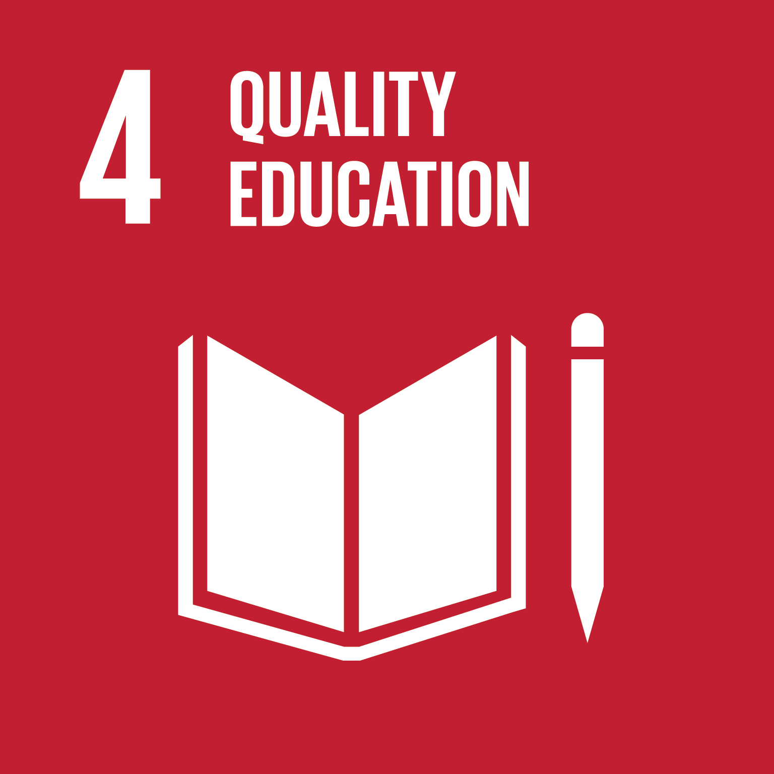
Goal 4: Ensure inclusive and equitable quality education and promote lifelong learning opportunities for all
4.1 By 2030, ensure that all girls and boys complete free, equitable and quality primary and secondary education leading to relevant and effective learning outcomes
4.2 By 2030, ensure that all girls and boys have access to quality early childhood development, care and pre-primary education so that they are ready for primary education
4.3 By 2030, ensure equal access for all women and men to affordable and quality technical, vocational and tertiary education, including university
4.4 By 2030, substantially increase the number of youth and adults who have relevant skills, including technical and vocational skills, for employment, decent jobs and entrepreneurship

Slide 21




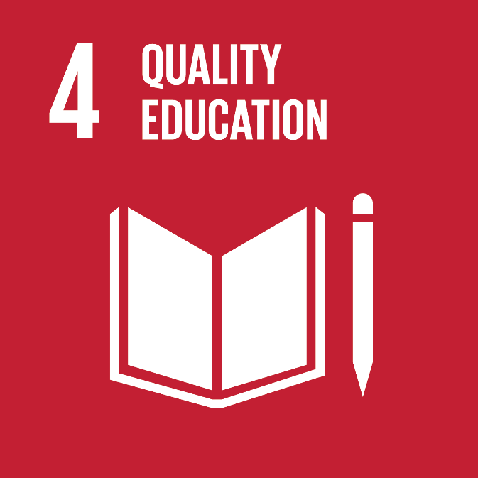

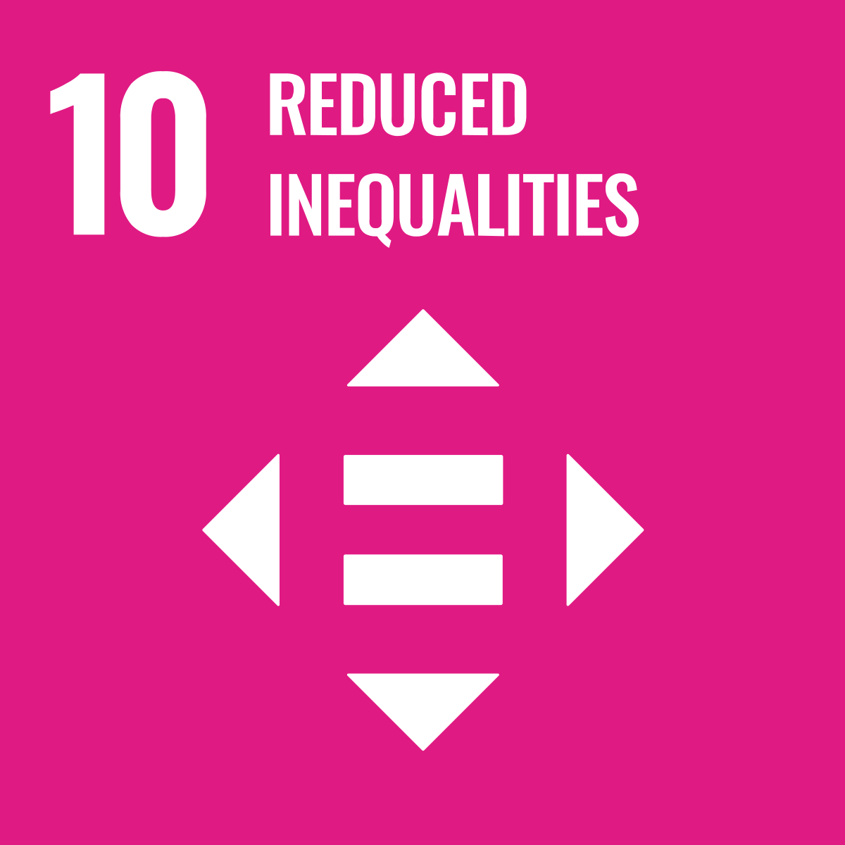


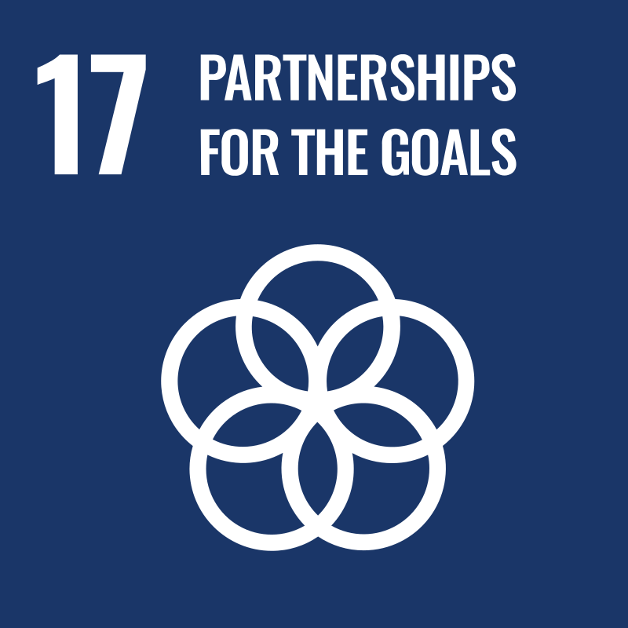

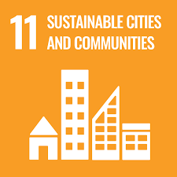
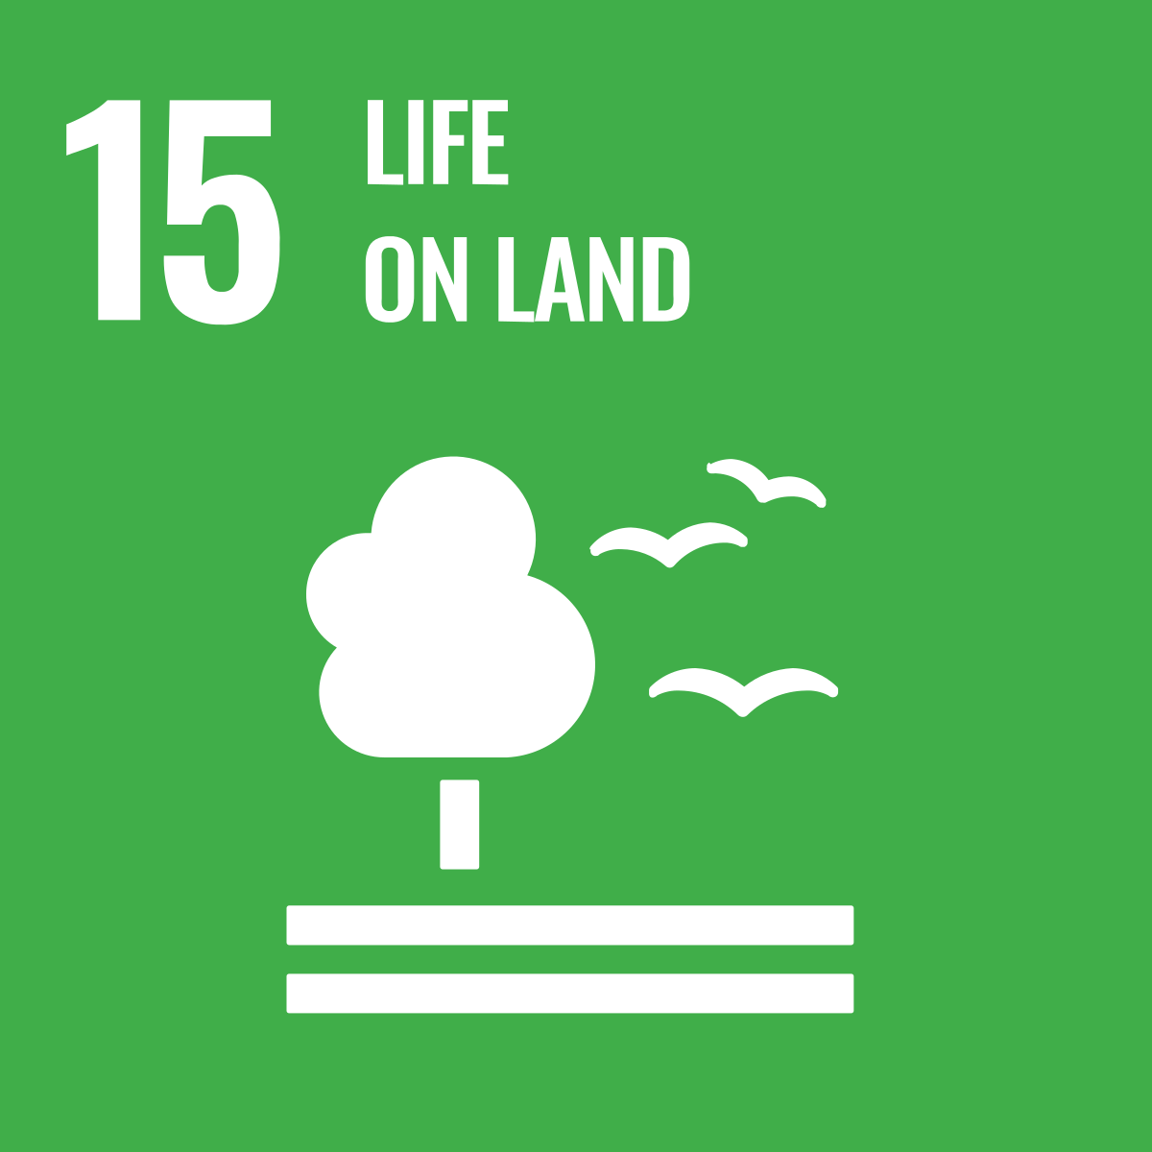




Re-Imagineering Higher Education
(Promoting Sustainable Development Goals)
Leads to promote all goals…

Slide 22

Shaping the Future of Higher Education Promoting Sustainable Development Goals
Higher Education is the driving force for establishing sustainability since it is one of the main communication vehicles and the basis for the “sustainability mindset”.
Higher Education institutions are viewed as “changing agents” and “catalysts” in the development of sustainability-related issues
SDGs are forcing higher education institutions to change to respond to a world in crisis.

Slide 23
Shaping the Future of Higher Education Promoting Sustainable Development Goals
Higher education institutions have a great responsibility to form future sustainability leaders and support the ambitious SDGs targets implementation.
Sustainability is also an essential aspect of a university's reputation globally.
Higher education institutions need to be drivers of culture change and develop curricula based on sustainability concepts.

Slide 24

Shaping the Future of Higher Education Promoting Sustainable Development Goals
Education is the basis for the achievement of all the SDGs and has an essential contribution to the formation of a society willing to support different SDGs aspects (e.g., global citizenship, gender equality, respect for human rights).
Despite the key role in social transformation,
several challenges and barriers need to be tackled inside the higher education institutions (e.g., curricula, ethical principles),
externally (e.g., different types of audiences, political environment, stakeholders' interest), that need to be tackled for the realization of the world that we want.

Slide 25

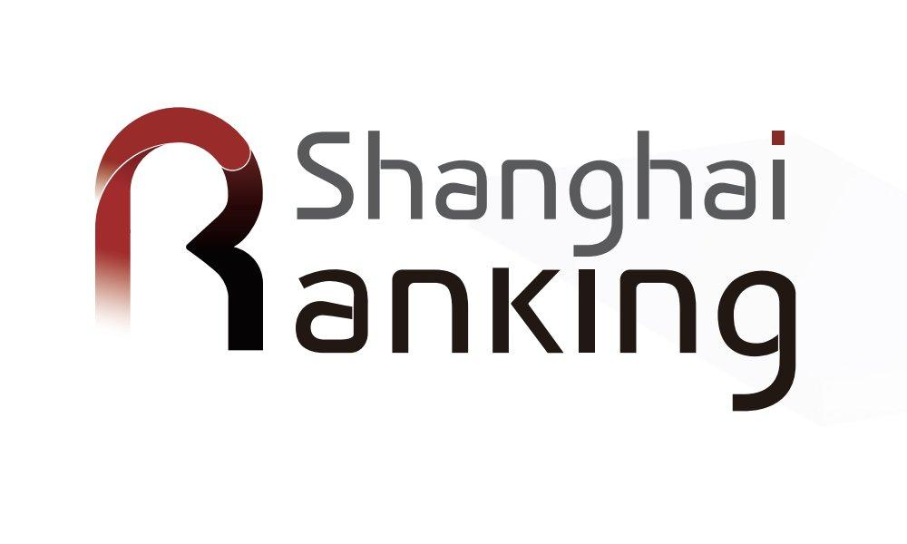
World University Rankings
Rankings | Indicators
QS World University Ranking | Citations per faculty, Academic reputation, Employer reputation, Faculty/student ratio, International student ratio International faculty ratio.
Shanghai Ranking | Quality of Education Quality of Faculty, Highly Cited Researchers Research Output Per Capita Performance

Slide 26
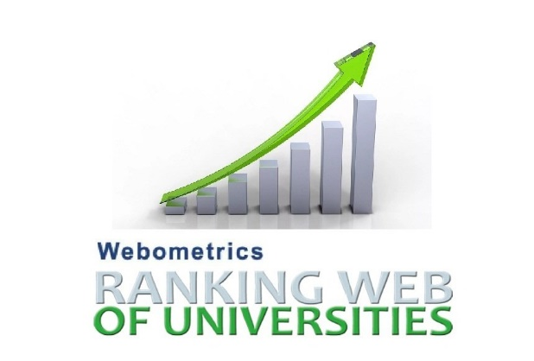
World University Rankings
Rankings | Indicators
UNIRANKS | Student Well-being, Facilities Awards Employability local & international ranks Internationalization & Diversity Academic & Researchers Quality of Education Web Impact Digitalization & Smart Campus Elite Manual Audit
Webometrics university ranking | The volume of the Web content (number of web pages and files) Visibility and impact of these web publications according to the number of external in links (site citations) they received.

Slide 27
World University Rankings
Times Higher Education (THE) World University Rankings This is a ranking list compiled by UK Times Higher Education (THE). In 2010, THE split from its previous partner Quacquarelli Symonds and started to collaborate with Thomson Reuters to create a separate ranking list based on a new set of assessing criteria:
Criteria | Weight
Teaching - the learning environment | 30%
Research - volume, income, and reputation | 30%
Citations - research influence | 30%
Industry income - innovation | 2.5%
International outlook - staff, students, and research | 7.5%

Slide 28


Future of Higher Education Report (2023)
Mobile World Capital Barcelona is an initiative driving the digital advancement of society while helping improve people’s lives globally.
Prepared
By
A global, purpose-driven consulting firm, dedicated to IMAGINING, INSPIRING, and IMPROVING education.

Slide 29


Future of Higher Education Report (2023)
The 7 Pillars of the Future of Higher Education
More Versity: more relevant, for more people, for longer, with more options and possibilities:
Digitization will make it possible to democratize access to learning.
This will give rise to a greater diversity of students and users.
Multiversity: multiple disciplines, itineraries, formats, and campuses:
The level of learning achieved and not memorization become the main vector of evaluation in this new paradigm.
The learning itineraries multiply.

Slide 30


Future of Higher Education Report (2023)
The 7 Pillars of the Future of Higher Education
Eco-systemic: interaction with the ecosystem of actors in the education value chain increases the economic and social impact of the university
Purposeful: the university institution has a mission and students will look for schools with purpose and values in line with the changing priorities of the new generations

Slide 31


Future of Higher Education Report (2023)
The 7 Pillars of the Future of Higher Education
Pathways and traces: training itineraries based on skills, abilities and areas of interest. Few entrances and many exits. And through multiple educational institutions
Augmented learning experience: digital technologies amplify the learning experience while transforming the role of the teacher

Slide 32

Future of Higher Education Report (2023)
The 7 Pillars of the Future of Higher Education
From surviving to thriving in uncertainty: the new challenges resulting from a changing environment will give rise to leadership with new attributes such as a digital mentality, a vision of the future or being a facilitator of change

Slide 33
Future of Higher Education Report (2023)
Each institution begins this journey from a particular existing core which will determine how fast and how much can be accomplished.
Core: This is what the university stands for, it is the center of its identity. Inside the core are:
The strengths and potential of their faculty,
The value of their local/international/physical/digital/ presence,
The depth and breadth of their programs,
The diversity of their learners/cohorts/alumni/faculty,
Their value-added services, and partnerships.

Slide 34
Future of Higher Education Report (2023)
University layers can be designed to allow institutions to address different sets of learners:
By the stage of learning they are at.
By their speed of learning.
By their depth of learning.
By their breadth of learning.
By their degree of physical vs digital experiences.
By the intensity and frequency of support.
By their connection to local and global issues.
By the type of validation required.
By mixing and developing cross-empathy among types of learners

Slide 35
Future of Higher Education Report (2023)
Some segments will experience differentiated levels of support. All of them will be able to realize their full potential as the institutions are working to create environments conducive to learning, to transform everyone into master learners, and to keep them engaged for life:
The more adaptable learner.
The more vulnerable learner.
The global learner.
The always-on learner.
The indigenous learner.
The in-campus-only learner.
The active collaboration learner.

Slide 36
Future of Higher Education Report (2023)
Learning In 3 Dimensions
Physical learning: Face-to-face activities with their differential value (trust, relationships, human emotions). The physical space provides learners with the necessary tools in their creative cycle of learning.
Digital learning: Complements, augments, and expands the experience using digital tools.
Phygital learning: Combines the key features of the physical and digital realms, providing an expanded experience.

Slide 37
Future of Higher Education Report (2023)
From the creative learning cycle and its processes, the report defined a model of proposed types of spaces and facilities needed to drive innovative learning. Specialized areas that confront learners to different types of spaces; all necessary for modern learning processes:
Meeting Area: Meet and connect with others, mutual inspiration. A place where the journey is not undertaken alone.
Discovery Zone: A place to start projects, and launch proposals.
Focus Zone: A place to reach maximum concentration, avoid distractions and reach depth.
Change Zone: Discover new routes, and exchange with areas outside your knowledge.
Creation Zone: The place to experiment, build, design, and prototype.
With such differentiated environments, learners freely combine the spaces according to the needs of their learning path.

Slide 38
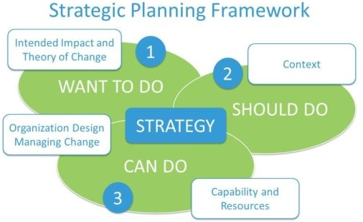
Re-Imagineering Higher Education
(Strategic Planning)
Steps in the Strategic Planning Process for Higher Education Institutions
Understand the current situation
Lead with vision and values
Concentrate your strategic planning efforts on key areas
Translate plan into tangible actions
Don’t forget to measure progress

Slide 39
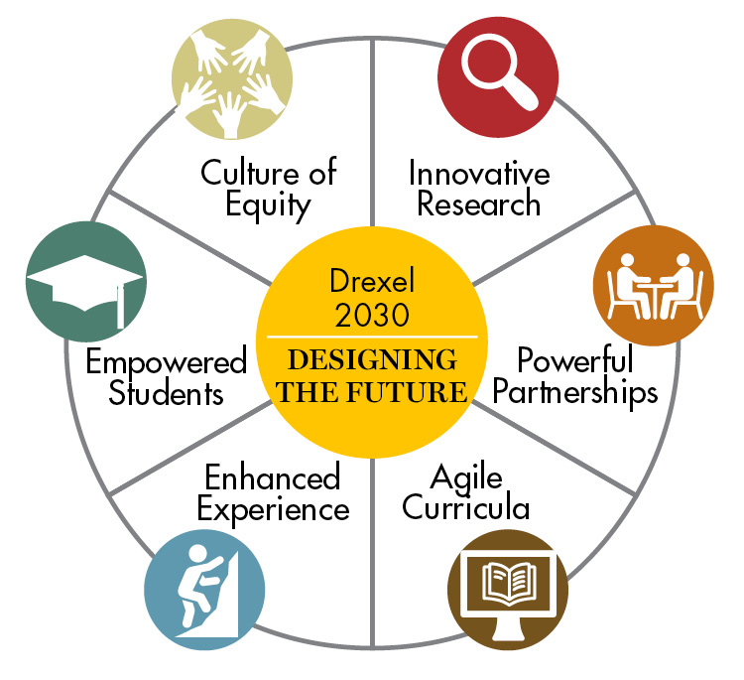

Re-Imagineering Higher Education (Strategic Planning)
Drexel University is a private research university with its main campus in Philadelphia, Pennsylvania. Drexel's undergraduate school was founded in 1891
Drexel’s 2030 plan is built upon six strategic imperatives to ensure institutional excellence.
Source: https://drexel.edu/strategicPlan/

Slide 40
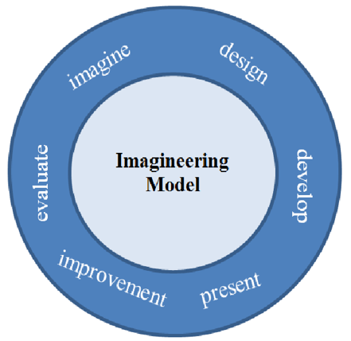
Re-Imagineering Higher Education
Imagineering is a combination of ‘imagination’ and ‘engineering.’
It brings art and science together to turn fantasy into reality and dreams into “magic.”
Therefore, ‘Imagineering’ means transforming imagination into concreteness.
In other words, it is a procedure of changing ideas into innovative products

Slide 41
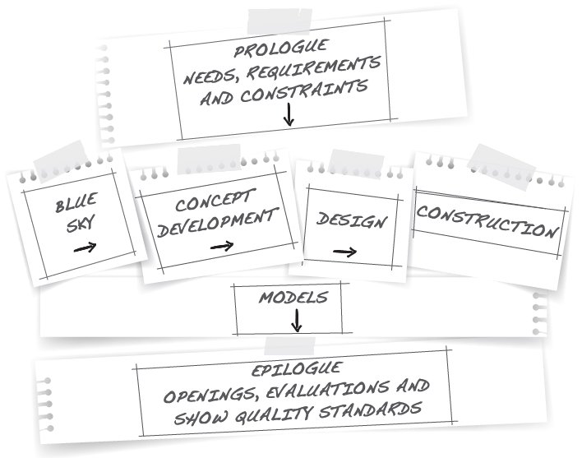
Re-Imagineering Higher Education
brainstorming with no limits
The Imagineering Process
Higher education needs identification

Slide 42


